Slide 1
أكـــــاديميــــة طــــويـــق
Scalable Data Science

Slide 2
Automated Workflows in the Cloud
By: Dr. Afshan Hashmi

Slide 3
Course Objectives:
Define cloud automation and its key components.
Design workflows using serverless architectures (e.g., AWS Step Functions, Azure Logic Apps).
Implement CI/CD pipelines for ML models in the cloud.
Automate data processing with cloud-native tools (e.g., Airflow, Lambda).
Evaluate cost/performance tradeoffs in workflow automation.

Slide 4
Introduction to Automation in the Cloud
What are Automated Workflows?
Automated workflows are sequences of tasks and processes that are triggered and executed automatically using predefined rules or events in cloud environments.
They eliminate the need for manual intervention and enhance efficiency, scalability, and reliability.
Cloud Automation refers to the use of technology (scripts, tools, or services) to perform tasks in cloud environments automatically, with minimal or no human involvement.
Purpose of Cloud Automation:
Reduce Human Error
Automated systems follow exact instructions every time eliminating mistakes that can happen with manual tasks.
Save Time
Tasks like server setup, deployments, or monitoring can be completed in seconds or scheduled regularly.
Improve Scalability & Response Time
Automatically adjust resources (like adding more servers) based on demand, ensuring smooth performance.

Slide 5
Common Examples:
Task | Automation Description
Auto-Scaling Infrastructure | Cloud platforms automatically add or remove computing resources (e.g., VMs or containers) based on load.
Scheduled Backups | Backups of data are taken at set intervals without manual effort, ensuring data safety.
Deployment Notifications | When code is deployed or updated, automated messages (via email, Slack, etc.) notify teams immediately.
Note: Tools like AWS CloudFormation, Terraform, Ansible,
and CI/CD pipelines (Jenkins, GitHub Actions) play key roles in automating cloud environments.

Slide 6
Key Components of Cloud Automation
These components work together to automate tasks in a cloud environment like an intelligent to-do list that runs itself based on events and conditions.
1. Triggers: Events that start an automated workflow.
Example: A new file uploaded to cloud storage (like Google Drive or AWS S3) could trigger a workflow to process it.
2. Actions: The specific tasks performed automatically when a trigger occurs.
Example: After a file is uploaded, an email is sent or a backup is created.
3. Conditions: Logic or rules that determine whether certain actions should be executed.
Example: If the uploaded file is a PDF, then process it; otherwise, ignore it.

Slide 7
Key Components of Cloud Automation
4. APIs & Connectors: Interfaces that connect different services and tools.
Example: Connecting Google Sheets to Slack or AWS to GitHub using REST APIs, webhooks, or prebuilt connectors.
5. Orchestration: The coordination of multiple actions across different systems in a defined sequence.
Example: After code is committed → test the code → deploy it → notify the team.
Putting It All Together:
Imagine this automated workflow:
Trigger: New file uploaded to Dropbox
Condition: File is a .csv
Action 1: Parse and analyze the file
Action 2: Upload results to Google Sheets
Action 3: Send summary via email
All coordinated through orchestration

Slide 8
Tools for Automating Workflows in the Cloud
Cloud providers like AWS, Azure, and GCP offer a variety of tools to automate tasks, respond to events, and orchestrate services all without manual intervention.
Amazon Web Services (AWS)
Tool | Purpose
AWS Lambda | Run small bits of code in response to events (like a file upload or API call). No server setup needed.
AWS Step Functions | Coordinate multiple AWS services in a sequence or workflow, like Lego blocks for automation.
Amazon EventBridge | Acts as a central event bus to connect applications and services based on real-time events.
AWS CloudWatch Events | Used to schedule automated jobs (like cron jobs) or respond to system events (e.g., CPU spikes).

Slide 9
Tools for Automating Workflows in the Cloud
Microsoft Azure
Tool | Purpose
Azure Logic Apps | Design workflows visually drag and drop components to build automation workflows across services.
Azure Functions | Event-driven serverless code runs when triggered (by a file upload, API call, timer, etc.).
Azure Automation | Automate repetitive tasks across Azure (and even non-Azure) environments like updating systems or starting/stopping VMs.

Slide 10
Tools for Automating Workflows in the Cloud
Google Cloud Platform (GCP)
Tool | Purpose
Cloud Functions | Lightweight, event-based serverless functions. Useful for quick tasks triggered by cloud events.
Cloud Workflows | Helps orchestrate sequences of Google Cloud services using YAML or JSON-based workflows.
Cloud Scheduler | Cron job service to schedule recurring tasks like sending emails, triggering pipelines, etc.

Slide 11
Real-World Examples of Cloud Automation
These examples show how cloud automation can simplify repetitive or time-sensitive tasks across different platforms.
Example 1: Daily File Backup
Trigger: Time-based — scheduled every day at 8 PM
Action: Automatically copy a file or database from the production environment to a backup storage location
Tools Used:
AWS Lambda – Executes the backup logic
S3 – Stores the backup
CloudWatch – Triggers Lambda on a schedule
This helps ensure that data is regularly backed up without needing a person to do it manually.

Slide 12
Real-World Examples of Cloud Automation
Example 2: Slack Notification for New GitHub Issue
Trigger: A new issue is opened on a GitHub repository
Action: Automatically send a message to a specific Slack channel with details of the new issue
Tools Used:
Zapier (no-code)
Or Azure Logic Apps (workflow builder)
Or GCP Workflows for developers
This keeps your team in the loop in real time without constantly checking GitHub.

Slide 13
Real-World Examples of Cloud Automation
Example 3: Auto-Scaling EC2 Instances
Trigger: When CPU usage > 80% on current EC2 instances
Action: Automatically launch a new EC2 instance to handle the load
Tools Used:
AWS Auto Scaling – Adjusts the number of instances
CloudWatch Alarms – Monitors CPU usage and triggers scaling
This ensures performance under heavy load while saving costs when usage drops.

Slide 14
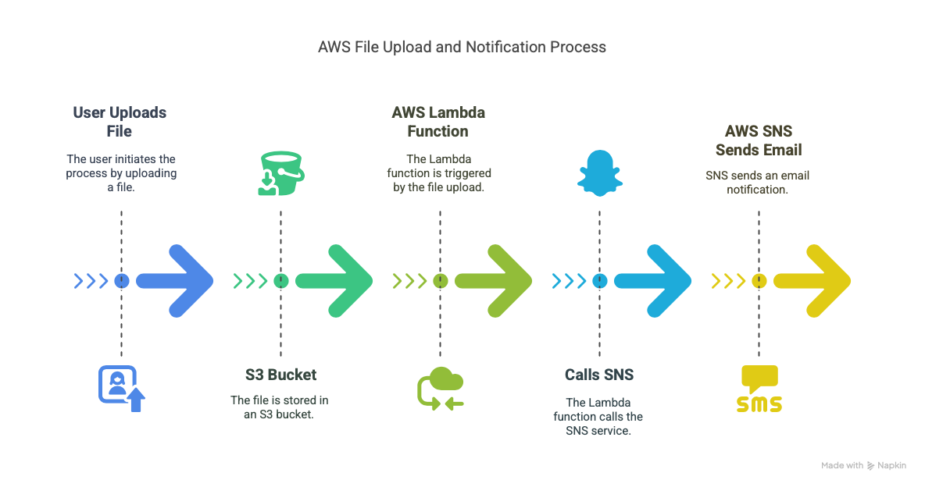
Hands-On Exercise: Notify via Email When a File is Uploaded
Platform: AWS
Scenario Flow
File Upload A user uploads a file to an Amazon S3 bucket.
Trigger Lambda The file upload triggers an AWS Lambda function through an S3 event.
Send Email Notification The Lambda function uses AWS SNS (Simple Notification Service) to send an email alert.

Slide 15
Hands-On Exercise: Notify via Email When a File is Uploaded
import json
import boto3
def lambda_handler(event, context):
# Get uploaded file name from the S3 event
s3_info = event['Records'][0]['s3']['object']['key']
# Create an SNS client
sns = boto3.client('sns')
# Send an email via SNS
sns.publish(
TopicArn='arn:aws:sns:region:acct-id:topic', # Replace with your SNS topic ARN
Message=f'New file uploaded: {s3_info}',
Subject='Upload Notification'
)
return {
'statusCode': 200,
'body': json.dumps('Notification sent!')
}

Slide 16
Hands-On Exercise: Notify via Email When a File is Uploaded
Explanation of Key Parts
Part | Description
event['Records'][0]['s3']['object']['key'] | Extracts the filename from the upload event.
boto3.client('sns') | Initializes the SNS client.
sns.publish(...) | Sends a message to the specified SNS topic, which then sends the email.
TopicArn | The unique identifier for the SNS topic connected to email subscribers.

Slide 17
Best Practices for Automated Workflows
These practices ensure your automated workflows are secure, maintainable, and reliable.
Use Environment Variables
What it means: Instead of hardcoding sensitive data (like API keys, database URIs, file paths), use environment variables.
B. Why it matters:
Keeps your code cleaner
Makes deployments more flexible across dev, staging, and production
Enhances security by avoiding hardcoded secrets
Example: Instead of writing db_password = 'abc123', store it in os.environ['DB_PASSWORD'].

Slide 18
Best Practices for Automated Workflows
2. Limit Permissions (Least-Privilege Principle)
What it means: Give your automation only the minimum permissions it needs to function.
Why it matters:
Reduces risk if a service or script is compromised
Prevents accidental changes to critical resources
Example: A Lambda function that only reads from S3 should not have write or delete permissions.
3. Monitor & Log All Actions
What it means: Track workflow actions and issues through logging and monitoring services.
Why it matters:
Helps in debugging and auditing
Ensures visibility into system health and workflow status
Tools:
AWS: CloudWatch
GCP: Stackdriver
Azure: Application Insights

Slide 19
Best Practices for Automated Workflows
4. Integrate Error Handling
What it means: Plan for failures by writing code that can catch and handle errors gracefully.
Why it matters:
Avoids broken workflows and silent failures
Enables retries or alerts when something goes wrong
Example: Use try-except blocks in Python Lambda functions to catch API failures and log them or trigger alerts.
5. Modularize Logic
What it means: Break your workflows into small, reusable modules or steps.
Why it matters:
Easier to debug, test, and maintain
Encourages reusability of logic across multiple workflows
Example: Instead of one large function, have separate ones for validation, transformation, and sending data.

Slide 20
Best Practices for Automated Workflows
Practice | Benefit
Environment Variables | Flexibility & Security
Least Privilege Permissions | Better Security
Monitoring & Logging | Debugging, Auditing, Transparency
Error Handling | Reliability & Workflow Continuity
Modular Logic | Maintainability & Reusability

Slide 21

Summary
Cloud-based automated workflows help execute tasks like backups, notifications, and deployments without manual intervention.
Triggers (e.g., file upload, scheduled time) initiate actions such as sending emails or scaling infrastructure.
Common cloud services for automation include AWS Lambda, Azure Logic Apps, and Google Cloud Functions.
These workflows can connect multiple cloud services using APIs or orchestration tools like AWS Step Functions or GCP Workflows.
Automation improves efficiency, reduces human error, and ensures consistency across processes.
Best practices include setting up monitoring, logging, error handling, and using the principle of least privilege for security.
Tools like Zapier and IFTTT offer no-code automation for connecting third-party services easily.

Slide 22
Reading and Resources
AWS Docs: https://docs.aws.amazon.com/lambda
Azure Logic Apps: https://learn.microsoft.com/en-us/azure/logic-apps
GCP Workflows: https://cloud.google.com/workflows/docs
Automate.io and Zapier (No-code tools)
"Cloud Automation Cookbook" by Nikit Swaraj (Packt)
YouTube: Cloud Academy, AWS Tutorials, Microsoft Learn

Slide 23


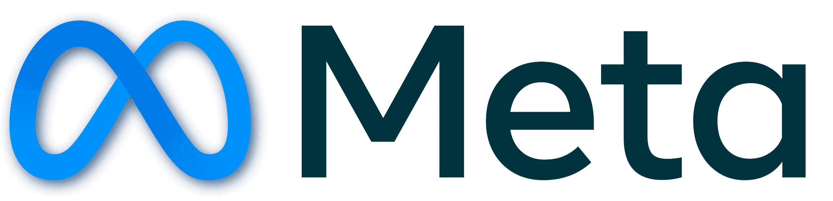














الشراكات العالمية

Slide 24
شــــــكــــرًا لكــــــم
THANK YOU

